Slide 1

Basic’s of Single Board Computer
Lecturer: Reza Arjmandi
Summer 2016
Preface:
Introduction SBC, Raspberry pi, Setup and management

Slide 2
The aim is…
What is a SBC (Single-Board Computer)?
What is a Embedded System?
What should we learn?

Slide 3
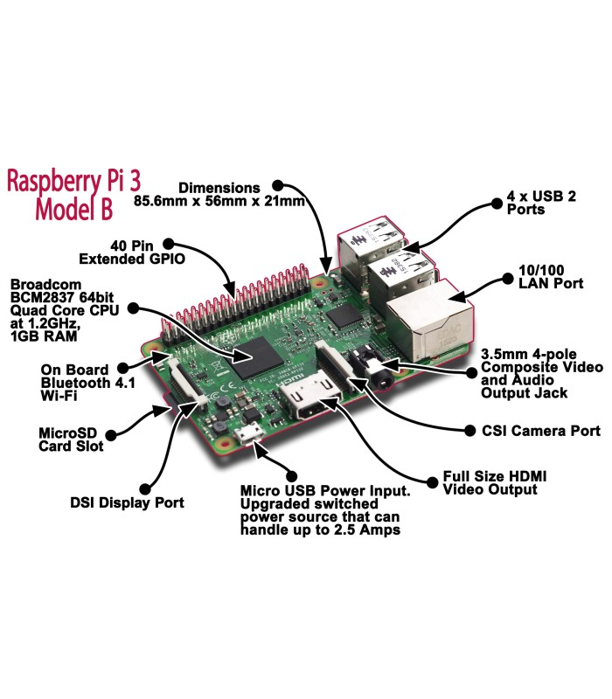
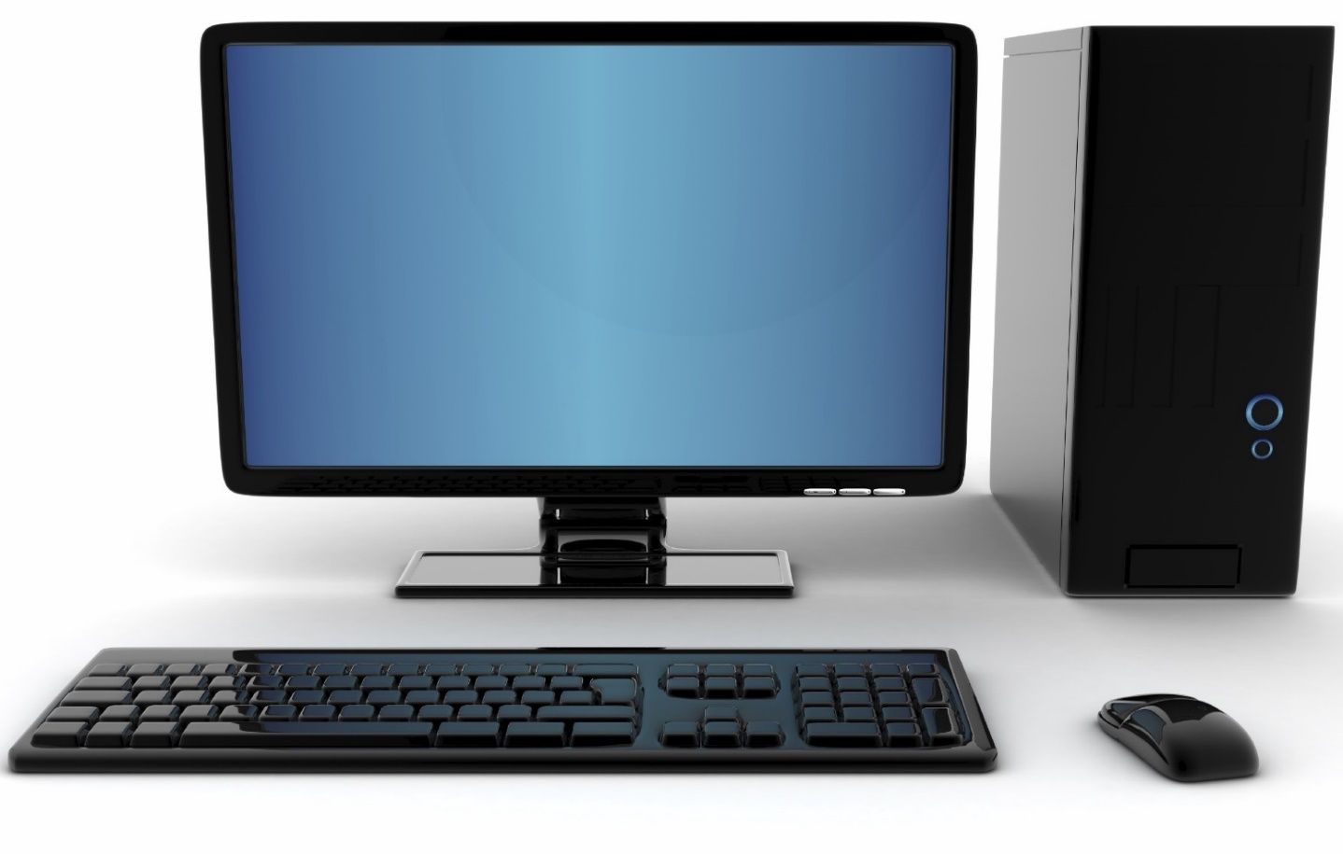
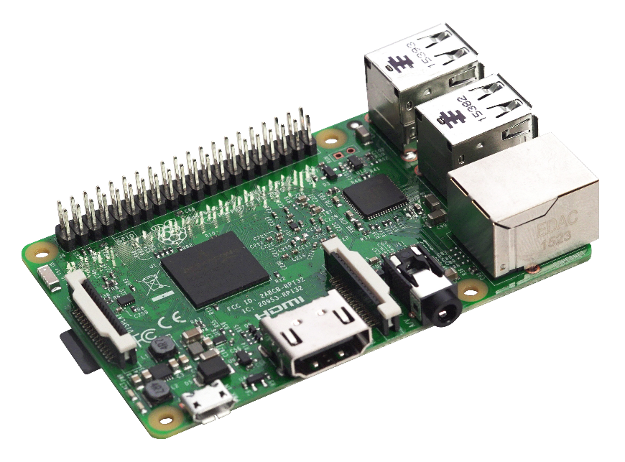
Single Board computer

Slide 4
Producer
Raspberry pi
ODROID
Orange Pi
BeagleBone Black
Friendly ARM
Microsoft
…

Slide 5
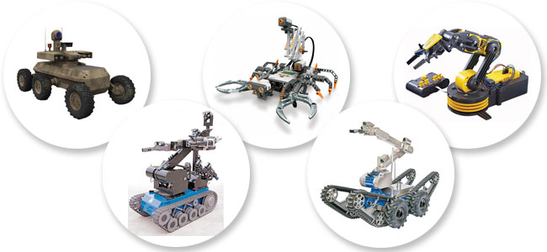
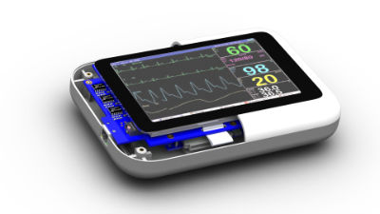
Application
Robotic
Home Automation
Video Game
Computer vision
Home Security
Mechatronics
Networking
سایر زمینه ها: Secret Agents
و به طور کلی در طراحی یک Embdded System

Slide 6
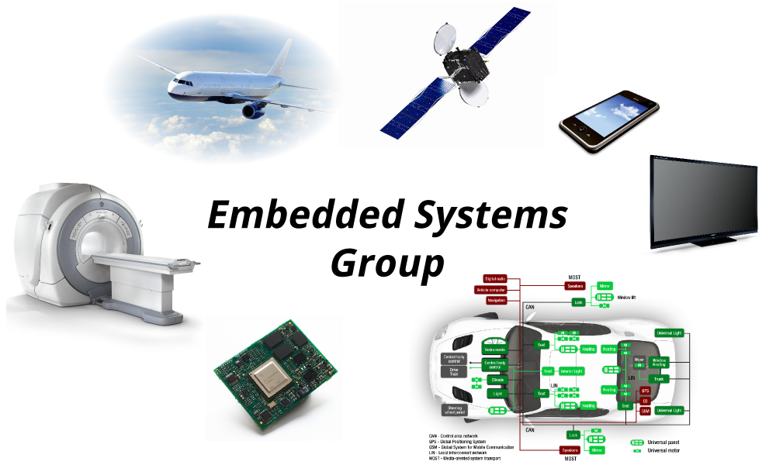
Application-Embedded systems
مراحل طراحی سیستم های تعبیه شده با Raspberry:
(OS) Platform
Networking
programming
Interfacing
Controlling Hardware

Slide 7
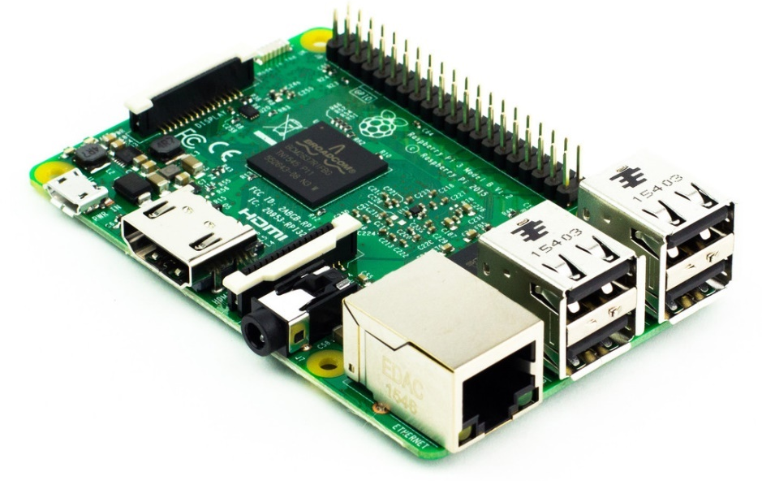
Raspberry pi-Platform
-Operation System->Linux Based Computer
Raspbian
OSMC
Ubuntu Mate
Windows 10 IOT core
LibreElec
...
-Software Programming
-develop with ready library

Slide 8
Raspberry pi-Networking
Hardware:
Wired Networking
LAN
I2C
USART
SPI
Wireless Networking
Wifi
Bluetooth
Internet
Software:
Web based application
Internet of things
Remote Control
SSH
DHCP

Slide 9



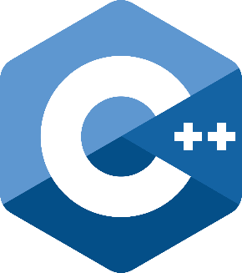
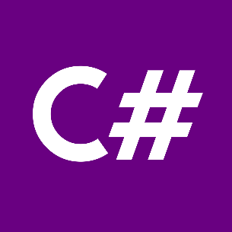
Raspberry pi-Programming
What should we learn?
Software Programming interface:
CLI
GUI
Web
…
Python IDE: IDLE

Slide 10
Python
Python is a programming language that lets you work quickly and integrate systems more effectively
Use Python for…
Web Programming: Django, Pyramid, Bottle, Tornado, Flask, web2py
GUI Development: wxPython, tkInter, PyGtk, PyGObject, PyQt
Scientific and Numeric: SciPy, Pandas, IPython
Software Development: Buildbot, Trac, Roundup
System Administration: Ansible, Salt, OpenStack

Slide 11
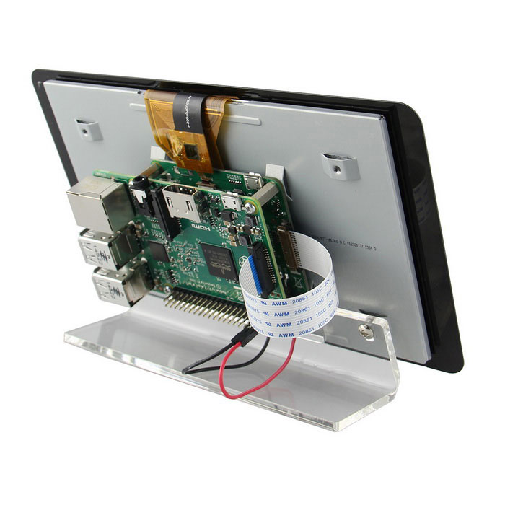
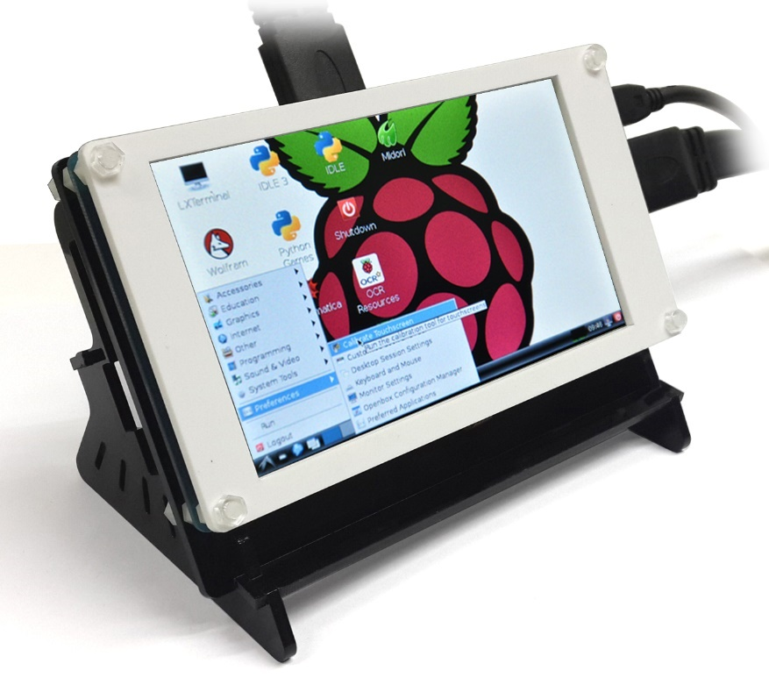
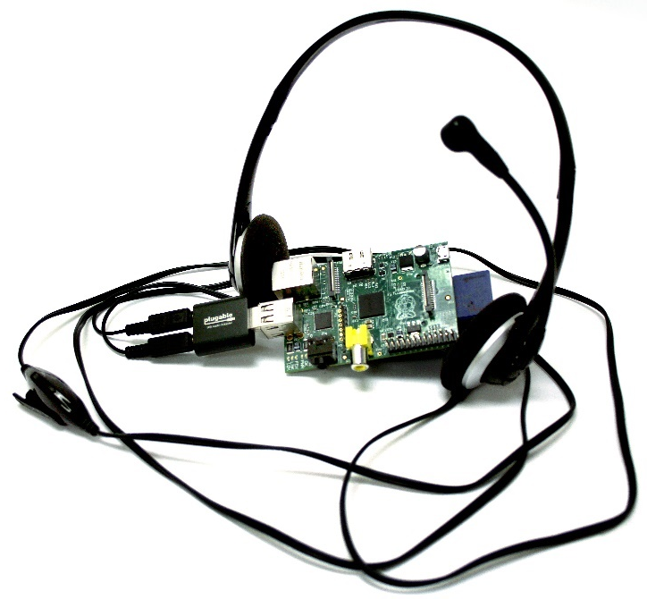
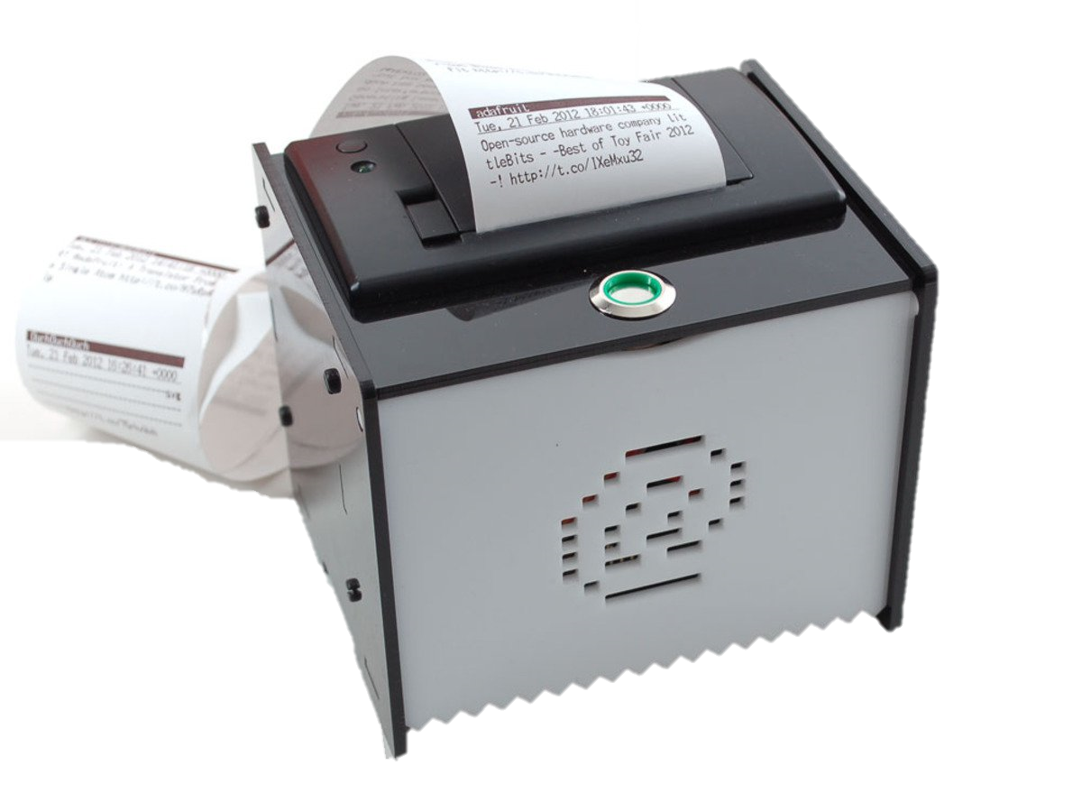
User Interfacing
HDMI Port
DSI Display Port
GPIO LCD
Touch Screen
Keyboard
Mouse
Audio Output
Printer
….

Slide 12
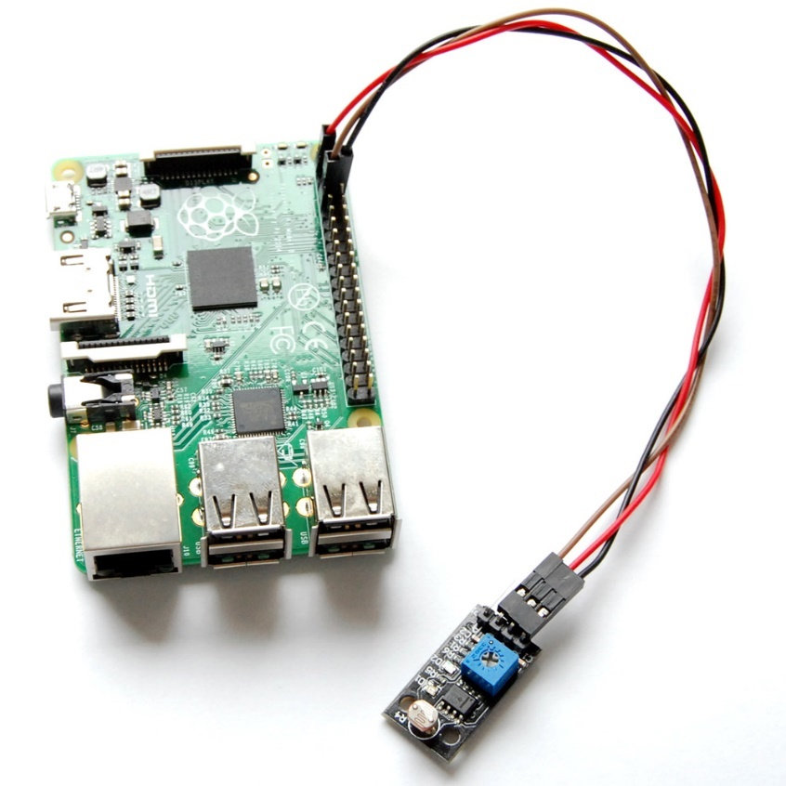
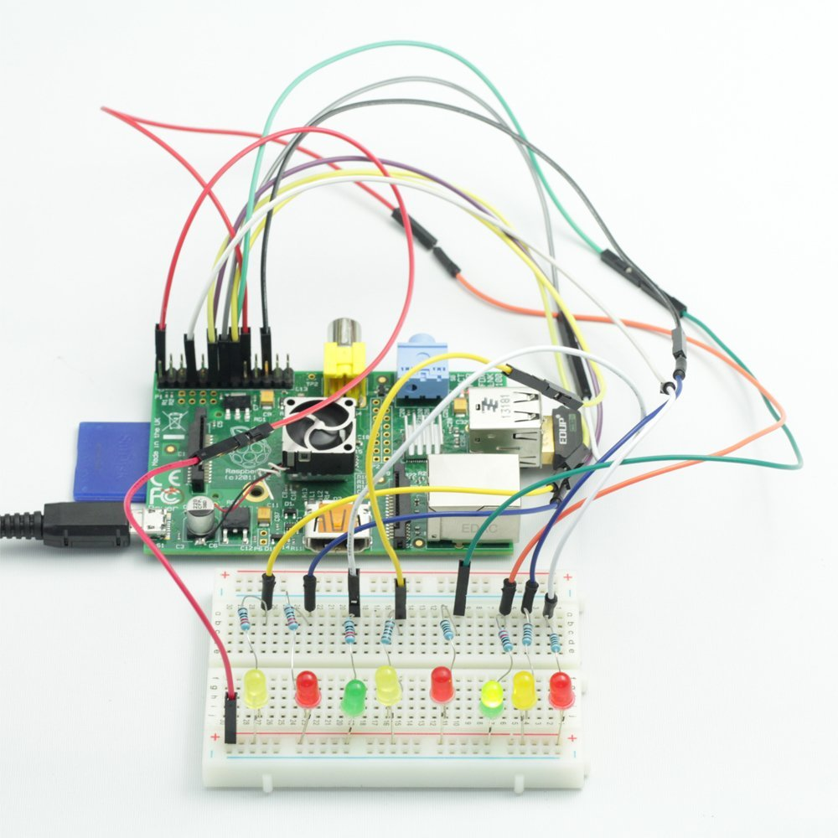
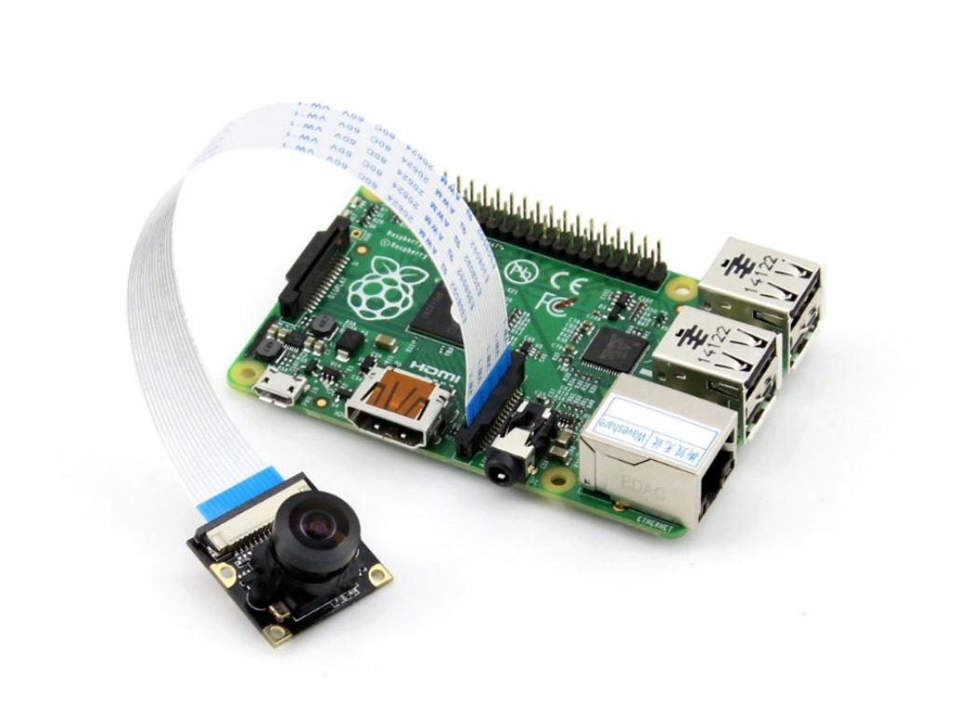
Controlling Hardware
ارتباط سنسورهای مختلف از طریق:GPIO - I2C – SPI – UART و ...
سنسوها و ماژول های گوناگون:
رله، ماژول تشخیص حرکت، سنسور دما، موتور DC، موتور پله ای، موتور سروو، ...
ماژول دوربین و ماژول LCD، ماژول کنترل دور موتور و...

Slide 13


Contact us
www.e-system.ir
Info@e-system.ir

